Slide 1
Flow Networks
A flow network G = (V, E) is a directed graph in which each edge (u, v) ∈ E has a positive capacity c(u, v) > 0.
If (u, v) ∉ E, we define c(u, v) = 0.
Each flow network contains two distinguished nodes: a source s and a sink t.
For convenience, we assume that each node lies on some path from the source to the sink.

Slide 2
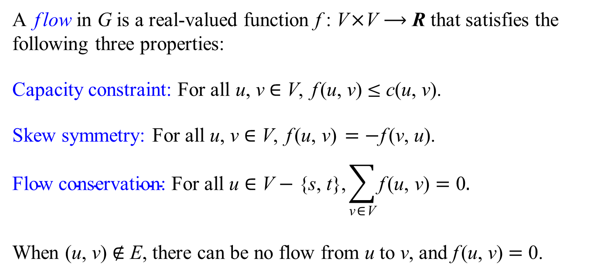
Flow
A flow in G is a real-valued function f : V×V ⟶ R that satisfies the following three properties:
Capacity constraint: For all u, v ∈ V, f (u, v) ≤ c(u, v).
Skew symmetry: For all u, v ∈ V, f (u, v) = −f (v, u).
$$\text{Flow} \text{conservation}\text{: }\text{For} \text{all} \text{u} \text{∈} \text{V} \text{−}\text{ \{}\text{s}\text{, }\text{t}\text{\},}\sum_{\text{v}\text{∈}\text{V}}{\text{f} \text{(}\text{u}\text{, }\text{v}\text{)}}=\text{0}.$$
When (u, v) ∉ E, there can be no flow from u to v, and f (u, v) = 0.

Slide 3
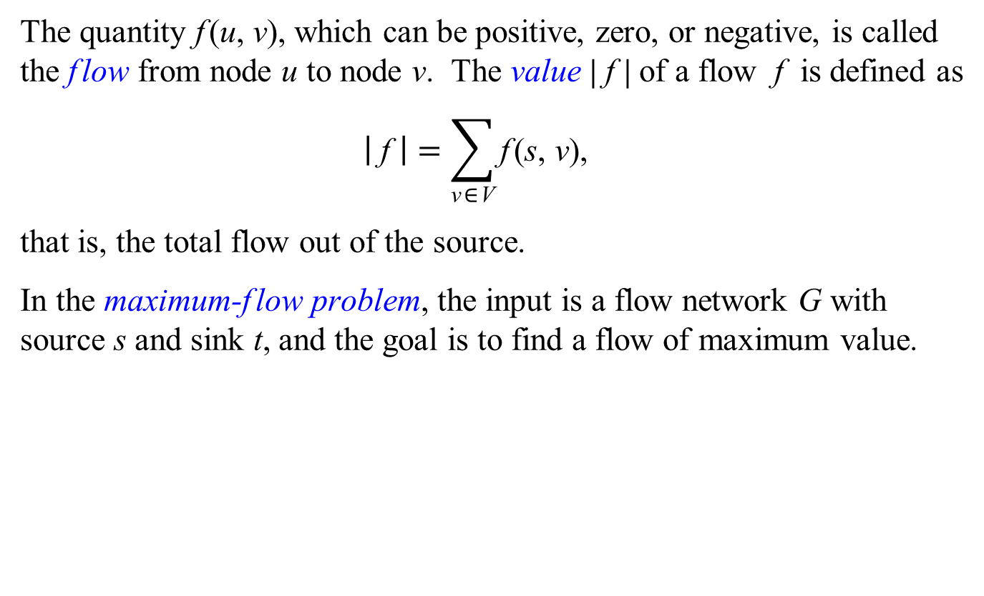
The Maximum-flow Problem
The quantity f(u, v), which can be positive, zero, or negative, is called the flow from node u to node v. The value |f| of a flow f is defined as
$$\left| \text{f} \right|=\sum_{\text{v}\text{∈}\text{V}}{\text{f}\text{(}\text{s}\text{, }\text{v}\text{)}\text{,}}$$
that is, the total flow out of the source.
In the maximum-flow problem, the input is a flow network G with source s and sink t, and the goal is to find a flow of maximum value.

Slide 4
Residual Networks
For a flow network G = (V, E ) with source s, sink t, and a flow f, consider a pair of nodes u, v ∈ V. We define the residual capacity rc(u, v) by
rc(u, v) = c(u, v) − f (u, v).
The residual network of G induced by f is R = (V, E′), where
E′ = {(u, v) ∈ V×V : rc(u, v) > 0}.
The residual network of G induced by f is R = (V, E′), where
E′ = {(u, v) ∈ V×V : (u, v) ∈ E or (v, u) ∈ E}, in which each edge (u, v) ∈ E′ is assigned the residual capacity rc(u, v).

Slide 5
G
rc(u, v) = c(u, v) − f (u, v)
E′ = {(u, v) ∈ V×V :
E′ = {(u, v) ∈ E or (v, u) ∈ E}
R

Slide 6
We assume that the nodes of G = (V, E) are numbered 1, 2, ..., n, where n = |V|, and let f[u][v] and rc[u][v] be n×n 2-d arrays.
FordFulkerson(G, s, t)
1 for each node u ∈ G.V
2 for each node v ∈ G.V
3 f[u][v] = 0, rc[u][v] = c(u, v) rc(u, v) = c(u, v) − f (u, v)
4 maxflow = 0
5 while there exists a path p from s to t in the residual network R
such that for each edge (u, v) in p, rc[u][v] > 0
6 rc(p) = min{rc[u][v] : (u, v) is in p}
7 maxflow = maxflow + rc(p)
8 for each edge (u, v) in p
9 f[u][v] = f[u][v] + rc(p)
11 f[v][u] = f[v][u] − rc(p)
12 return maxflow

Slide 7
Suppose that Lucky Puck ship 4 crates per day from v₁ to v₂ and 3 crates per day from v₂ to v₁. It may seem natural to represent these shipments directly by flows, but we cannot. The skew-symmetry constraint requires that f(v₁, v₂) = −f(v₂, v₁), but this is clearly not the case if we consider f(v₁, v₂) = 4 and f(v₂, v₁) = 3.

Slide 8
Lucky Puck may realize that it is pointless to ship 4 crates per day from v₁ to v₂ and 3 crates from v₂ to v₁, when they could achieve the same net effect by shipping 1 crates from v₁ to v₂ and 0 crates from v₂ to v₁. We represent this latter scenario with a flow: we have f(v₁, v₂) = 1 and f(v₂, v₁) = −1. In effect, 3 of the 4 crates per day from v₁ to v₂ are canceled by 3 crates per day from v₂ to v₁.

Slide 9
G
f[u][v] = f[u][v] + rc(p)
f[v][u] = f[v][u] − rc(p)
rc(u, v) = c(u, v) − f (u, v)
R

Slide 10
G
f[u][v] = f[u][v] + rc(p)
f[v][u] = f[v][u] − rc(p)
rc(u, v) = c(u, v) − f (u, v)
R

Slide 11
G
f[u][v] = f[u][v] + rc(p)
f[v][u] = f[v][u] − rc(p)
rc(u, v) = c(u, v) − f (u, v)
R

Slide 12
G
f[u][v] = f[u][v] + rc(p)
f[v][u] = f[v][u] − rc(p)
rc(u, v) = c(u, v) − f (u, v)
R

Slide 13
G
f[u][v] = f[u][v] + rc(p)
f[v][u] = f[v][u] − rc(p)
rc(u, v) = c(u, v) − f (u, v)
R

Slide 14
G
f[u][v] = f[u][v] + rc(p)
f[v][u] = f[v][u] − rc(p)
rc(u, v) = c(u, v) − f (u, v)
R

Slide 15
G
f[u][v] = f[u][v] + rc(p)
f[v][u] = f[v][u] − rc(p)
rc(u, v) = c(u, v) − f (u, v)
R

Slide 16
G
f[u][v] = f[u][v] + rc(p)
f[v][u] = f[v][u] − rc(p)
rc(u, v) = c(u, v) − f (u, v)
R

Slide 17
G
f[u][v] = f[u][v] + rc(p)
f[v][u] = f[v][u] − rc(p)
rc(u, v) = c(u, v) − f (u, v)
R

Slide 18
G
f[u][v] = f[u][v] + rc(p)
f[v][u] = f[v][u] − rc(p)
rc(u, v) = c(u, v) − f (u, v)
R

Slide 19
G
f[u][v] = f[u][v] + rc(p)
f[v][u] = f[v][u] − rc(p)
rc(u, v) = c(u, v) − f (u, v)
R

Slide 20
G
f[u][v] = f[u][v] + rc(p)
f[v][u] = f[v][u] − rc(p)
rc(u, v) = c(u, v) − f (u, v)
R

Slide 21
G
f[u][v] = f[u][v] + rc(p)
f[v][u] = f[v][u] − rc(p)
rc(u, v) = c(u, v) − f (u, v)
R

Slide 22
We assume that the nodes of G = (V, E) are numbered 1, 2, ..., n, where n = |V|, and let f[u][v] and rc[u][v] be n×n 2-d arrays.
FordFulkerson(G, s, t)
1 for each node u ∈ G.V
2 for each node v ∈ G.V
3 f[u][v] = 0, rc[u][v] = c(u, v) rc(u, v) = c(u, v) − f (u, v)
4 maxflow = 0
5 while there exists a path p from s to t in the residual network R
such that for each edge (u, v) in p, rc[u][v] > 0
6 rc(p) = min{rc[u][v] : (u, v) is in p}
7 maxflow = maxflow + rc(p)
8 for each edge (u, v) in p
9 f[u][v] = f[u][v] + rc(p)
11 f[v][u] = f[v][u] − rc(p)
12 return maxflow

Slide 23
We assume that the nodes of R = (V, E′) are numbered 1, 2, ..., n, where n = |V|, and let rc[u][v] be an n×n 2-d array.
FordFulkerson(R, s, t)
1 for each node u ∈ R.V
2 for each node v ∈ R.V
3 rc[u][v] = c(u, v) rc(u, v) = c(u, v) − f (u, v)
4 maxflow = 0
5 while there exists a path p from s to t in the residual network R
such that for each edge (u, v) in p, rc[u][v] > 0
6 rc(p) = min{rc[u][v] : (u, v) is in p}
7 maxflow = maxflow + rc(p)
8 for each edge (u, v) in p
9 rc[u][v] = rc[u][v] − rc(p)
10 rc[v][u] = rc[v][u] + rc(p)
11 return maxflow

Slide 24
Undirected Flow Networks
An undirected flow network G = (V, E) is an undirected simple graph in which each edge {u, v} ∈ E has a positive capacity c({u, v}) > 0.
If {u, v} ∉ E, then we define c({u, v}) = 0, and we disallow self-loops.
We distinguish two vertices in a flow network: a source s and a sink t.
For convenience, we assume that each node lies on some path from the source to the sink.
12
v₁
v₃
16
20
s
4
9
7
t
13
4
v₂
v₄
14

Slide 25
Jonatan Schroeder, André Pires Guedes and Elias P. Duarte Jr.
Computing the Minimum Cut and Maximum Flow of Undirected Graphs.
Universidade Federal do Paraná, Departamento de Informática, Relatório Técnico RT-DINF 003/2004,
Curitiba PR Brazil,
2004.

Slide 26
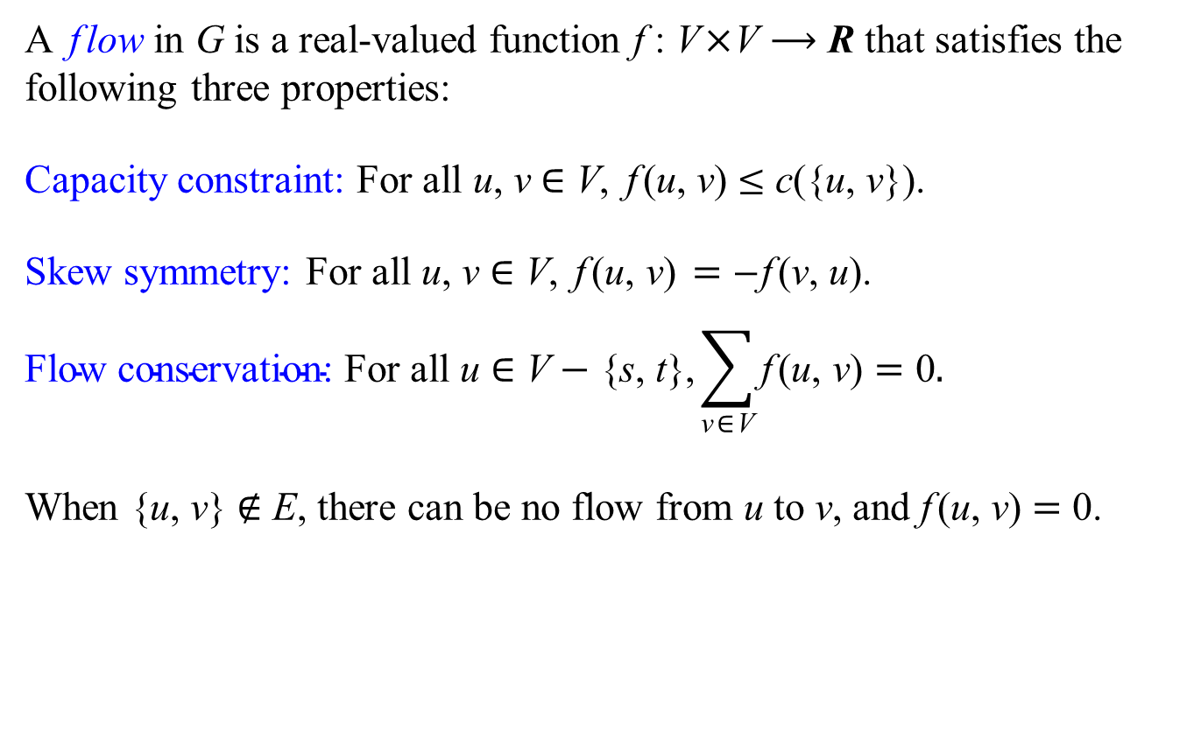
Flow
A flow in G is a real-valued function f : V×V ⟶ R that satisfies the following three properties:
Capacity constraint: For all u, v ∈ V, f(u, v) ≤ c({u, v}).
Skew symmetry: For all u, v ∈ V, f(u, v) = −f(v, u).
$$\text{Flow} \text{conservation}\text{: }\text{For} \text{all} \text{u} \text{∈} \text{V} \text{−}\text{ \{}\text{s}\text{, }\text{t}\text{\},}\sum_{\text{v}\text{∈}\text{V}}{\text{f} \text{(}\text{u}\text{, }\text{v}\text{)}}=\text{0}.$$
When {u, v} ∉ E, there can be no flow from u to v, and f(u, v) = 0.

Slide 27
An Example of Flow
f(s, v₁) = 12 f(s, v₂) = 12
f(v₁, s) = −12 f(v₁, v₂) = 0 f(v₁, v₃) = 12
f(v₂, s) = −12 f(v₂, v₁) = 0 f(v₂, v₃) = 1 f(v₂, v₄) = 11
f(v₃, v₁) = −12 f(v₃, v₂) = −1 f(v₃, v₄) = −7 f(v₃, t) = 20
f(v₄, v₂) = −11 f(v₄, v₃) = 7 f(v₄, t) = 4
f(t, v₃) = −20 f(v₂, v₄) = −4
For other pairs of nodes (u, v), f(u, v) = 0 f : V ×V → R

Slide 28
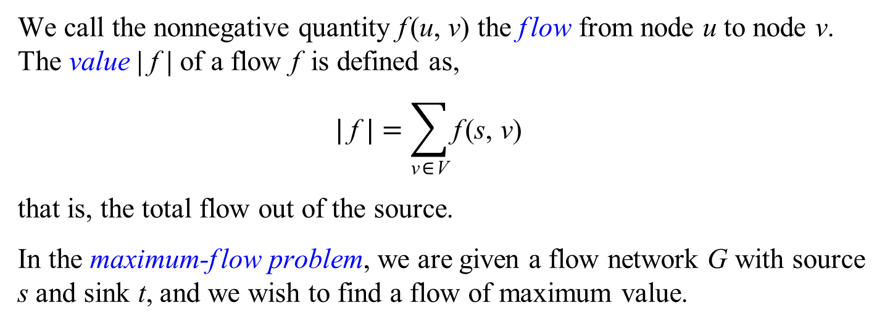
The maximum-flow problem
We call the nonnegative quantity f(u, v) the flow from node u to node v. The value |f| of a flow f is defined as,
$$| \text{f} |=\sum_{\text{v}\text{∈}\text{V}}{\text{f}\text{(}\text{s}\text{, }\text{v}\text{)}}$$
that is, the total flow out of the source.
In the maximum-flow problem, we are given a flow network G with source s and sink t, and we wish to find a flow of maximum value.

Slide 29
Residual Networks
Suppose that we have an undirected flow network G = (V, E) with source s and sink t. Let f be a flow in G, and consider a pair of vertices u, v ∈ V. We define the residual capacity rc(u, v) by
rc(u, v) = c({u, v}) − f(u, v).
The residual network of G induced by f is directed graph R = (V, E′), where E′ = {(u, v) ∈ V×V : c({u, v}) > 0}, or equivalently,
E′ = {(u, v) ∈ V×V : {u, v} ∈ E}.

Slide 30
G
rc(u, v) = c({u, v}) − f (u, v)
E′ = {(u, v) ∈ V×V : {u, v} ∈ E}
R

Slide 31
We assume that the nodes of R = (V, E′) are numbered 1, 2, ..., n, where n = |V|, and let rc[u][v] be an n×n 2-d array.
FordFulkerson(R, s, t)
1 for each node u ∈ R.V
2 for each node v ∈ R.V
3 rc[u][v] = c({u, v}) rc(u, v) = c({u, v}) − f (u, v)
4 maxflow = 0
5 while there exists a path p from s to t in the residual network R
such that for each edge (u, v) in p, rc[u][v] > 0
6 rc(p) = min{rc[u][v] : (u, v) is in p}
7 maxflow = maxflow + rc(p)
8 for each edge (u, v) in p
9 rc[u][v] = rc[u][v] − rc(p)
10 rc[v][u] = rc[v][u] + rc(p)
11 return maxflow

Slide 32
4 maxflow = 0
5 while there exists a path p from s to t in the residual network R
such that for each edge (u, v) in p, rc[u][v] > 0
6 rc(p) = min{rc[u][v] : (u, v) is in p}
7 maxflow = maxflow + rc(p)
8 for each edge (u, v) in p
9 rc[u][v] = rc[u][v] − rc(p)
10 rc[v][u] = rc[v][u] + rc(p)
0
maxflow

Slide 33
4 maxflow = 0
5 while there exists a path p from s to t in the residual network R
such that for each edge (u, v) in p, rc[u][v] > 0
6 rc(p) = min{rc[u][v] : (u, v) is in p}
7 maxflow = maxflow + rc(p)
8 for each edge (u, v) in p
9 rc[u][v] = rc[u][v] − rc(p)
10 rc[v][u] = rc[v][u] + rc(p)
0
maxflow

Slide 34
4 maxflow = 0
5 while there exists a path p from s to t in the residual network R
such that for each edge (u, v) in p, rc[u][v] > 0
6 rc(p) = min{rc[u][v] : (u, v) is in p}
7 maxflow = maxflow + rc(p)
8 for each edge (u, v) in p
9 rc[u][v] = rc[u][v] − rc(p)
10 rc[v][u] = rc[v][u] + rc(p)
4
maxflow

Slide 35
4 maxflow = 0
5 while there exists a path p from s to t in the residual network R
such that for each edge (u, v) in p, rc[u][v] > 0
6 rc(p) = min{rc[u][v] : (u, v) is in p}
7 maxflow = maxflow + rc(p)
8 for each edge (u, v) in p
9 rc[u][v] = rc[u][v] − rc(p)
10 rc[v][u] = rc[v][u] + rc(p)
4
maxflow

Slide 36
4 maxflow = 0
5 while there exists a path p from s to t in the residual network R
such that for each edge (u, v) in p, rc[u][v] > 0
6 rc(p) = min{rc[u][v] : (u, v) is in p}
7 maxflow = maxflow + rc(p)
8 for each edge (u, v) in p
9 rc[u][v] = rc[u][v] − rc(p)
10 rc[v][u] = rc[v][u] + rc(p)
12
maxflow

Slide 37
4 maxflow = 0
5 while there exists a path p from s to t in the residual network R
such that for each edge (u, v) in p, rc[u][v] > 0
6 rc(p) = min{rc[u][v] : (u, v) is in p}
7 maxflow = maxflow + rc(p)
8 for each edge (u, v) in p
9 rc[u][v] = rc[u][v] − rc(p)
10 rc[v][u] = rc[v][u] + rc(p)
12
maxflow

Slide 38
4 maxflow = 0
5 while there exists a path p from s to t in the residual network R
such that for each edge (u, v) in p, rc[u][v] > 0
6 rc(p) = min{rc[u][v] : (u, v) is in p}
7 maxflow = maxflow + rc(p)
8 for each edge (u, v) in p
9 rc[u][v] = rc[u][v] − rc(p)
10 rc[v][u] = rc[v][u] + rc(p)
19
maxflow

Slide 39
4 maxflow = 0
5 while there exists a path p from s to t in the residual network R
such that for each edge (u, v) in p, rc[u][v] > 0
6 rc(p) = min{rc[u][v] : (u, v) is in p}
7 maxflow = maxflow + rc(p)
8 for each edge (u, v) in p
9 rc[u][v] = rc[u][v] − rc(p)
10 rc[v][u] = rc[v][u] + rc(p)
19
maxflow

Slide 40
4 maxflow = 0
5 while there exists a path p from s to t in the residual network R
such that for each edge (u, v) in p, rc[u][v] > 0
6 rc(p) = min{rc[u][v] : (u, v) is in p}
7 maxflow = maxflow + rc(p)
8 for each edge (u, v) in p
9 rc[u][v] = rc[u][v] − rc(p)
10 rc[v][u] = rc[v][u] + rc(p)
24
maxflow

Slide 41
We assume that the nodes of R = (V, E′) are numbered 1, 2, ..., n, where n = |V|, and let rc[u][v] be an n×n 2-d array.
FordFulkerson(R, s, t)
1 for each node u ∈ R.V
2 for each node v ∈ R.V
3 rc[u][v] = c({u, v})
4 maxflow = 0
5 while there exists a path p from s to t in the residual network R
such that for each edge (u, v) in p, rc[u][v] > 0
6 rc(p) = min{rc[u][v] : (u, v) is in p}
7 maxflow = maxflow + rc(p)
8 for each edge (u, v) in p
9 rc[u][v] = rc[u][v] − rc(p)
10 rc[v][u] = rc[v][u] + rc(p)
11 return maxflow

Slide 42
void bfs( int s )
{
memset( parent, -1, sizeof( parent ) );
parent[ s ] = s;
queue< int > q;
q.push( s );
while( !q.empty() )
{
int u = q.front();
q.pop();
if( u == t )
return;
for( int v : adjList[ u ] )
if( resCap[ u ][ v ] > 0 && parent[ v ] == -1 )
{
parent[ v ] = u;
q.push( v );
}
}
}

Slide 43
int edmondsKarp( int s, int t )
{
int maxFlow = 0;
while( true )
{
bfs();
if( parent[ t ] == -1 )
return maxFlow;
int minResCap = inf;
for( int v = t; v != s; v = parent[ v ] )
minResCap = min( minResCap, resCap[ parent[ v ] ][ v ] );
maxFlow += minResCap;
for( int v = t; v != s; v = parent[ v ] )
{
resCap[ parent[ v ] ][ v ] -= minResCap;
resCap[ v ][ parent[ v ] ] += minResCap;
}
}
}

